Slide 1
Demand-side flexibility
.
.
.
Quantification of the benefits in 2030 for EU-27
.
Hans de Heer
28th September 2022

Slide 2
The role of demand-side flexibility in a future, carbon-low energy system
Why this study?
Demand-side flexibility (DSF)…
is a frequently overlooked solution in policy decisions
lacks visibility as a reliable, efficient and climate-friendly solution
has unclear potential as it has never been systematically quantified
still faces regulatory barriers due to a slow implementation of the electricity market directive
Objectives
Quantify the potential benefits of a full deployment of DSF in the EU by 2030
Identify the role of DSF against the Fit for 55 and REPowerEU objectives
Examine all relevant markets
Scope
In this study, DSF:
includes flexibility from buildings, electric vehicles and industry
includes demand management, energy storage and distributed generation
excludes large-scale batteries, electrolysers and central generation assets

Slide 3
DSF improves efficiency, reliability and sustainability
EU’s 55% GHG reduction target by 2030, will be achieved and exceeded by a full deployment of the DSF potential, but would not be met without DSF
In 2030, the power system can serve all demand all year long, when the DSF potential is fully deployed. This is not the case without DSF deployment
Main value of DSF is created in wholesale markets, yet the value for adequacy, balancing and grid infrastructure is still relevant

Slide 4
Emphasis of this study is on wholesale benefits
WHOLESALE MODELLING
MAIN SCENARIO
REFERENCE SCENARIO
GENERATION ADEQUACY, BALANCING AND GRID INFRASTRUCTURE
DNV has used a fundamental market model that simulates the day-ahead spot price by optimizing the unit commit-ment and economic dispatch of electricity generation
It contains a representation of generation, commodity prices, demand and interconnectivity for all bidding zones in EU 27
Based on Fit-for-55 and REPower policy targets
Assets such as EV chargers, heat pumps, industrial load, batteries are fully exposed to the market, within technical and user’s constraints.
In the “no-DSF” scenario, all DSF has been regarded as fully price-inelastic
With some DSF already participating in markets, this reference scenario should not be considered as “BaU"
The results provide an indication of the missed opportunity when DSF is not fully deployed
Benefits have been calculated outside the market model.
Calculations are based on market model data and results, as well as on literature.

Slide 5
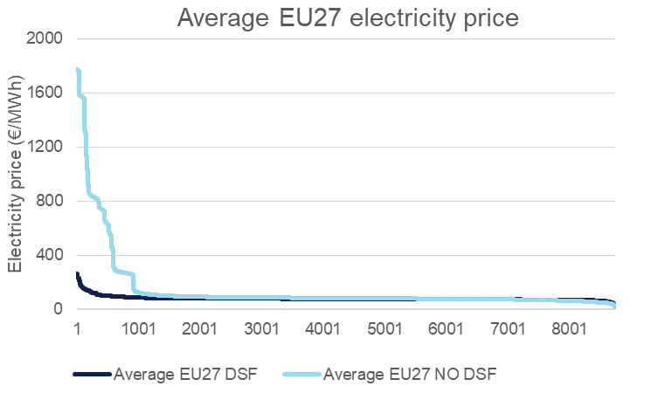
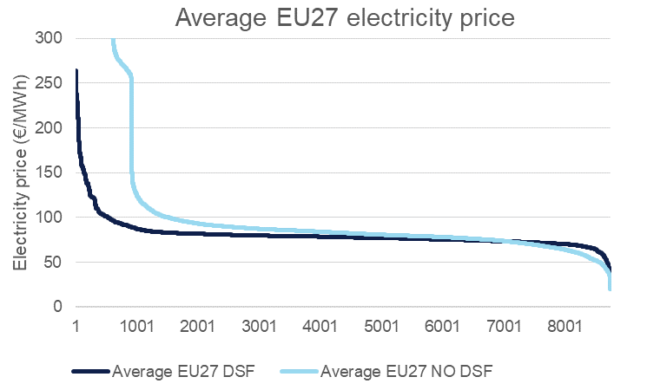
Quantitative results for 2030
Wholesale benefits
€301,5 billion in indirect annual benefits from reductions in energy prices
€4.6 billion (5%) savings due to lower costs to generate electricity
Renewable energy curtailment reduces by 15.5 TWh (61%)
37.5 million tonnes (8%) saved in annual GHG emission
System benefits
Avoidance of at least 60 GW of generation capacity
Savings in European balancing markets of €262–690 million
€11.1–29.1 billion saved in grid investment needs annually
In summary, benefits for consumers
Customers with flexible assets benefit directly (more than €71 billion per year)
All customers benefit from lower wholesale prices and system costs (over €300 billion per year)

Slide 6
Recommendations
Assess and resolve any regulatory, economic and/or business (case) challenges that may cause bottlenecks to further DSF deployment
Investigate to what extent the full potential will develop on its own – assuming all regulatory barriers are removed – or whether additional incentives are needed, as we have seen and continue to see for batteries, electrolysers, and renewables
Improve transparency on the current deployment of DSF throughout EU 27 by introducing market monitoring on DSF availability and deployment
Further investigate the quantification of infrastructural benefits of DSF
Investigate energy-efficiency potential resulting from DSF deployment

Slide 7
Demand-side flexibility
Quantification of the benefits in 2030 for EU-27
hans.deheer@dnv.com

